Slide 1


Tutorial 02 – Markov Models
02360765 PARLAI Spring 2026

Slide 2
Map of Models
Markov Decision Process
Partially Observable Markov Decision Process
Factored (PO)MDP
Markov Chains
Hidden Markov Models
Dynamic Bayesian Networks
Bayesian Networks

Slide 3
Today
Passive models known as Stochastic Processes.
No actions / control / decisions
Temporal probabilistic dynamics
Dynamic Bayesian Networks
Non Temporal
Markov Chains
Hidden Markov Models
Bayesian Networks

Slide 4
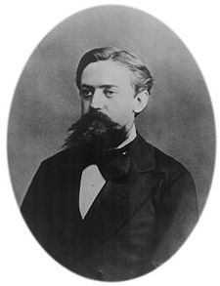
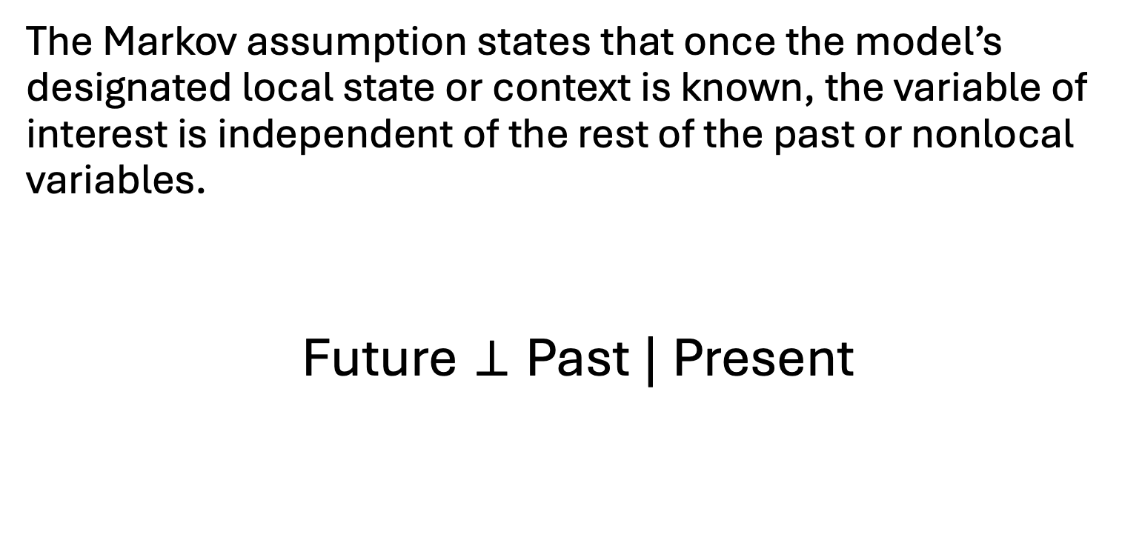
The Markov Assumption
The Markov assumption states that once the model’s designated local state or context is known, the variable of interest is independent of the rest of the past or nonlocal variables.
$$\text{Future}⊥\text{Past} | \text{Present}$$
Andrey Markov (1856-1922)

Slide 5

Running Example: Office Delivery Robot
A robot delivers letters and packages to employees in an office building.
It traverses between different rooms to find the package recipients.
We will define this problem using each of the probabilistic models to demonstrate their expressiveness and properties.

Slide 6
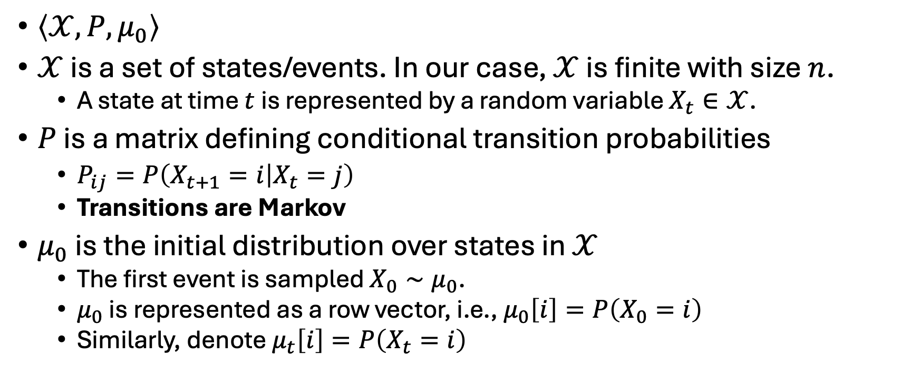
Markov Chains: Definition
$\left\langle 𝒳,P,μ_{0}\right\rangle$
$𝒳$ is a set of states/events. In our case, $𝒳$ is finite with size $n$.
A state at time $t$ is represented by a random variable $X_{t}∈𝒳$.
$P$ is a matrix defining conditional transition probabilities
$P_{ij}=P\left(X_{t+1}=i | X_{t}=j\right)$
Transitions are Markov
$μ_{0}$ is the initial distribution over states in $𝒳$
The first event is sampled $X_{0}∼μ_{0}$.
$μ_{0}$ is represented as a row vector, i.e., $μ_{0}\left[i\right]=P\left(X_{0}=i\right)$
Similarly, denote $μ_{t}\left[i\right]=P\left(X_{t}=i\right)$

Slide 7
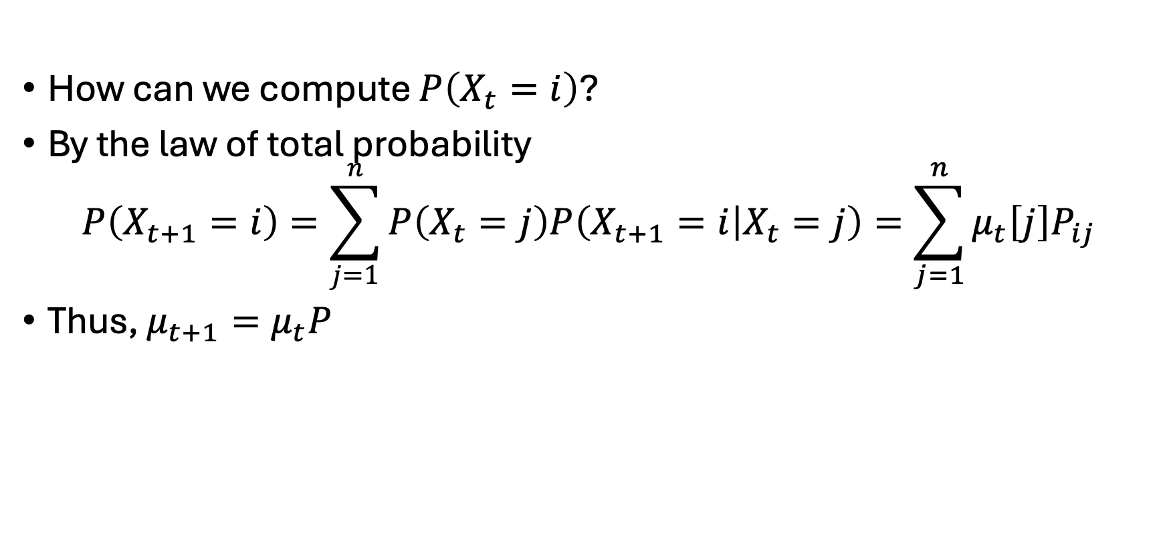
Markov Chains: Distribution Propagation
How can we compute $P\left(X_{t}=i\right)$?
By the law of total probability
$$P\left(X_{t+1}=i\right)=\sum_{j=1}^{n}{P\left(X_{t}=j\right)P\left(X_{t+1}=i | X_{t}=j\right)}=\sum_{j=1}^{n}{μ_{t}\left[j\right]P_{ij}}$$
Thus, $μ_{t+1}=μ_{t}P$

Slide 8
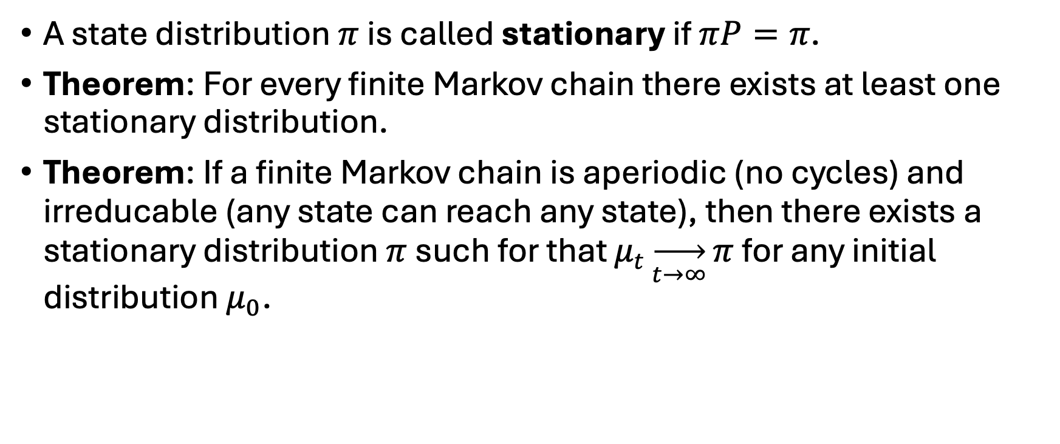
Markov Chains: Stationary Distributions
A state distribution $π$ is called stationary if $πP=π$.
Theorem: For every finite Markov chain there exists at least one stationary distribution.
Theorem: If a finite Markov chain is aperiodic (no cycles) and irreducable (any state can reach any state), then there exists a stationary distribution $π$ such for that $μ_{t}\overset{→}{t→∞}π$ for any initial distribution $μ_{0}$.
Freedman 2017

Slide 9
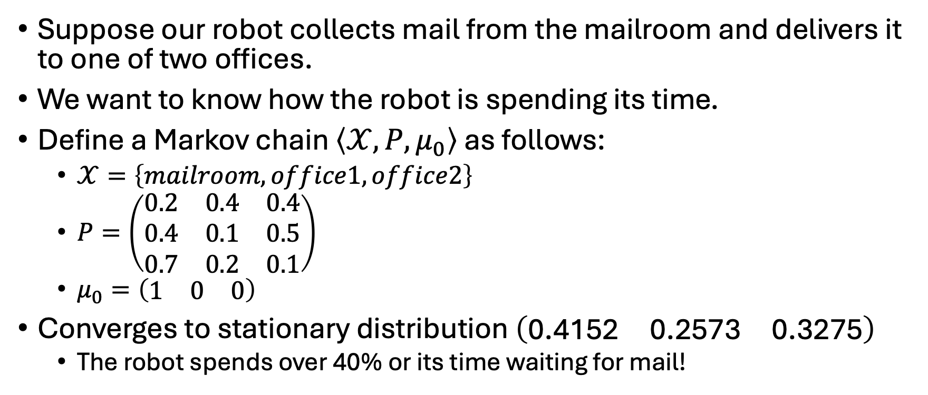
Markov Chains: Example
Suppose our robot collects mail from the mailroom and delivers it to one of two offices.
We want to know how the robot is spending its time.
Define a Markov chain $\left\langle 𝒳,P,μ_{0}\right\rangle$ as follows:
$𝒳=\left\{mailroom,office1,office2\right\}$
$P=\left(\begin{matrix}0.2 & 0.4 & 0.4 \\ 0.4 & 0.1 & 0.5 \\ 0.7 & 0.2 & 0.1\end{matrix}\right)$
$μ_{0}=\left(\begin{matrix}1 & 0 & 0\end{matrix}\right)$
Converges to stationary distribution $\left(\begin{matrix}\text{0.4152} & \text{0.2573} & \text{0.3275}\end{matrix}\right)$
The robot spends over 40% or its time waiting for mail!

Slide 10
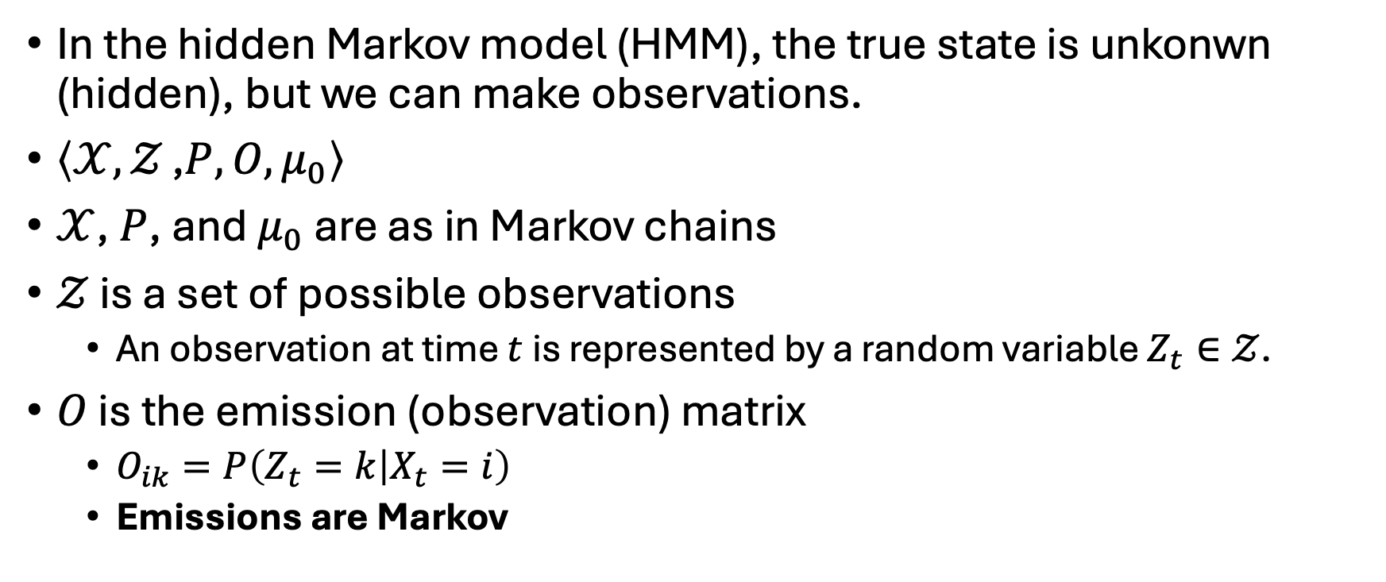
HMM: Definition
In the hidden Markov model (HMM), the true state is unkonwn (hidden), but we can make observations.
$\left\langle 𝒳,𝒵 \text{,}P,O,μ_{0}\right\rangle$
$𝒳$, $P$, and $μ_{0}$ are as in Markov chains
$𝒵$ is a set of possible observations
An observation at time $t$ is represented by a random variable $Z_{t}∈𝒵$.
$O$ is the emission (observation) matrix
$O_{ik}=P\left(Z_{t}=k | X_{t}=i\right)$
Emissions are Markov

Slide 11
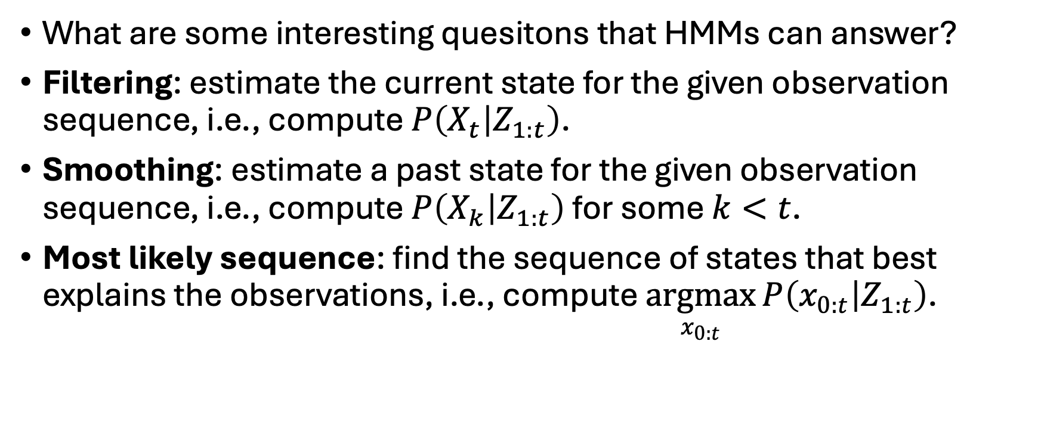
HMM: Inference Tasks
What are some interesting quesitons that HMMs can answer?
Filtering: estimate the current state for the given observation sequence, i.e., compute $P\left(X_{t} | Z_{1:t}\right)$.
Smoothing: estimate a past state for the given observation sequence, i.e., compute $P\left(X_{k} | Z_{1:t}\right)$ for some $k<t$.
Most likely sequence: find the sequence of states that best explains the observations, i.e., compute $\underset{x_{0:t}}{argmax}{P\left(x_{0:t} | Z_{1:t}\right)}$.

Slide 12
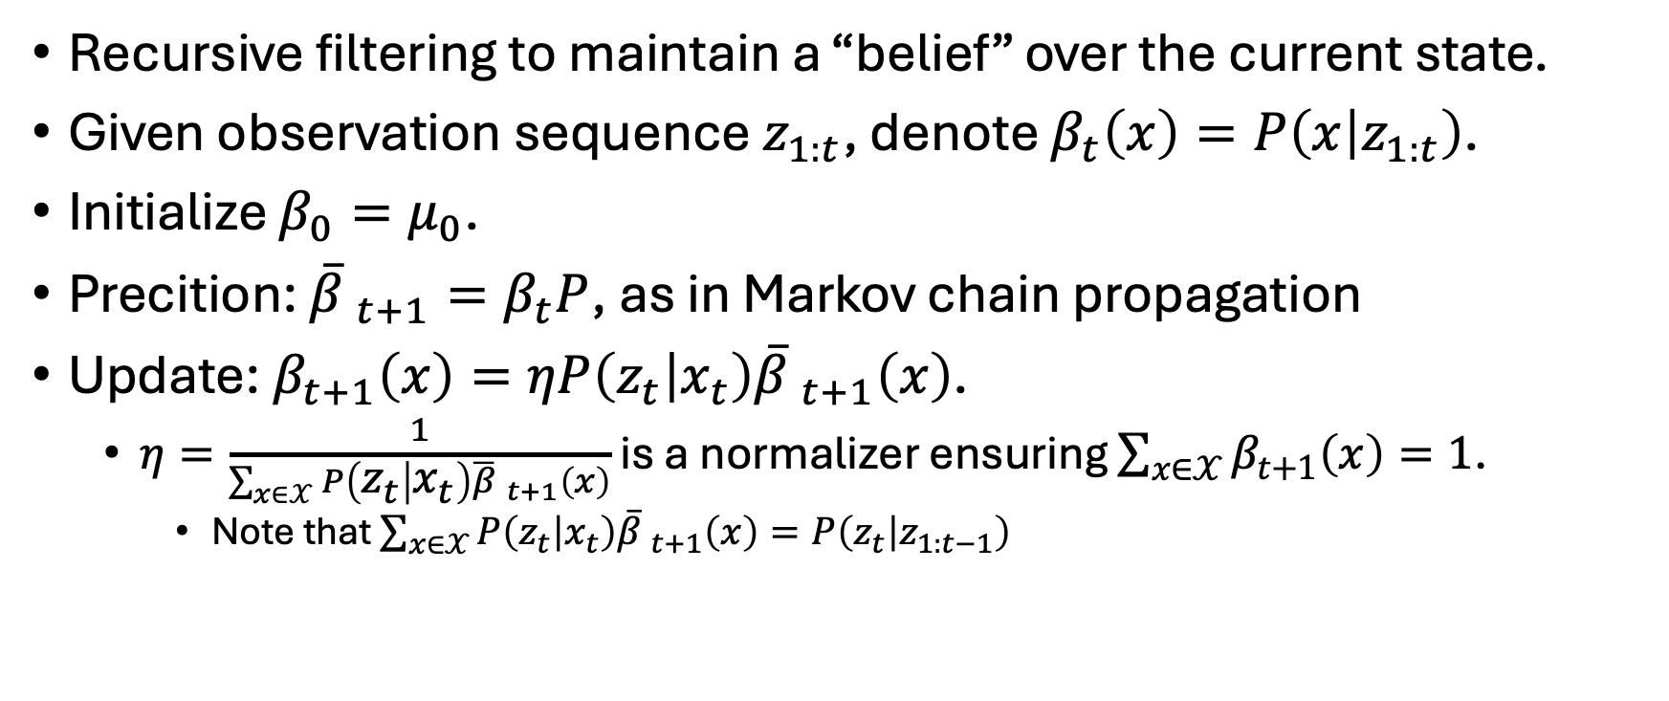
HMM: Belief Filtering
Recursive filtering to maintain a “belief” over the current state.
Given observation sequence $z_{1:t}$, denote $β_{t}\left(x\right)=P\left(x | z_{1:t}\right)$.
Initialize $β_{0}=μ_{0}$.
Precition: ${\overline{β} }_{t+1}=β_{t}P$, as in Markov chain propagation
Update: $β_{t+1}\left(x\right)=ηP\left(z_{t} | x_{t}\right){\overline{β} }_{t+1}\left(x\right)$.
$η=\frac{1}{\sum_{x∈𝒳}{P\left(z_{t} | x_{t}\right){\overline{β} }_{t+1}\left(x\right)}}$ is a normalizer ensuring $\sum_{x∈𝒳}{β_{t+1}\left(x\right)}=1$.
Note that $\sum_{x∈𝒳}{P\left(z_{t} | x_{t}\right){\overline{β} }_{t+1}\left(x\right)}=P\left(z_{t} | z_{1:t−1}\right)$

Slide 13
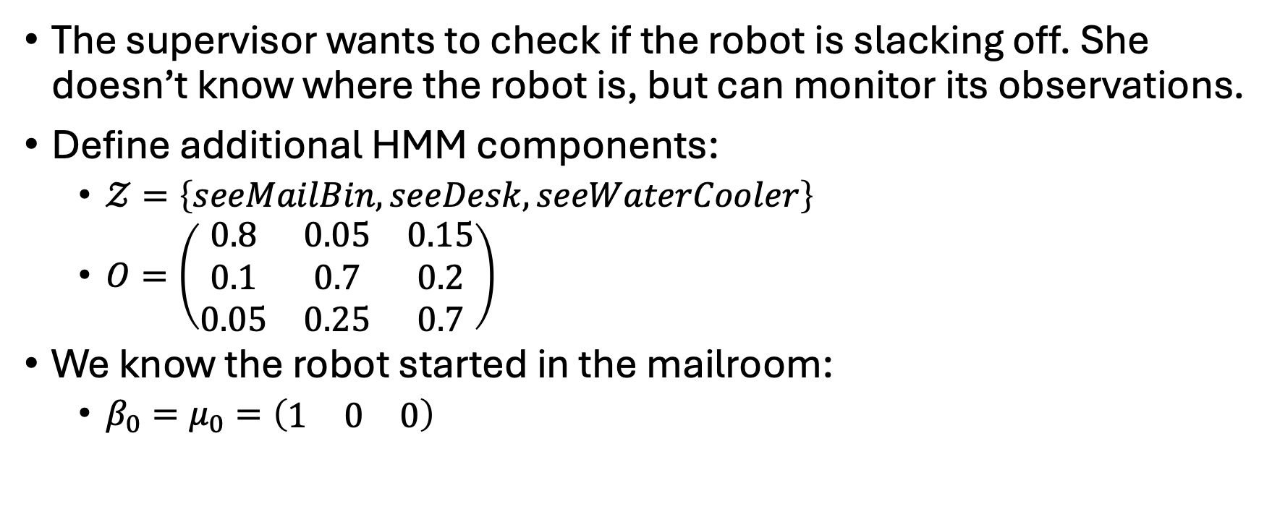
HMM: Example
The supervisor wants to check if the robot is slacking off. She doesn’t know where the robot is, but can monitor its observations.
Define additional HMM components:
$𝒵=\left\{seeMailBin,seeDesk,seeWaterCooler\right\}$
$O=\left(\begin{matrix}0.8 & 0.05 & 0.15 \\ 0.1 & 0.7 & 0.2 \\ 0.05 & 0.25 & 0.7\end{matrix}\right)$
We know the robot started in the mailroom:
$β_{0}=μ_{0}=\left(\begin{matrix}1 & 0 & 0\end{matrix}\right)$

Slide 14
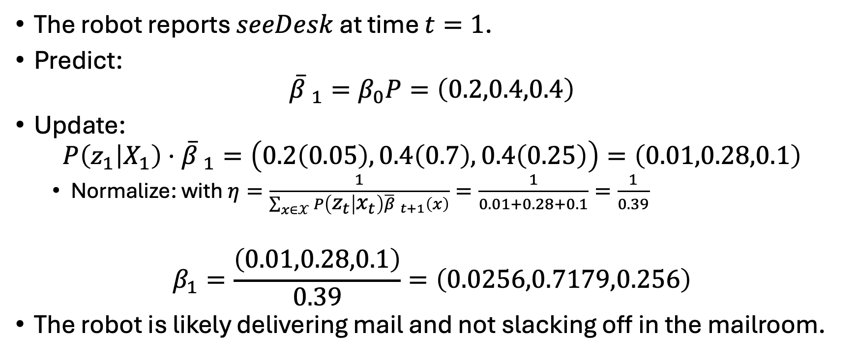
HMM: Example (cont.)
The robot reports $seeDesk$ at time $t=1$.
Predict:
$${\overline{β} }_{1}=β_{0}P=\left(0.2,0.4,0.4\right)$$
Update:
$$P\left(z_{1} | X_{1}\right)⋅{\overline{β} }_{1}=\left(0.2\left(0.05\right),0.4\left(0.7\right),0.4\left(0.25\right)\right)=\left(0.01,0.28,0.1\right)$$
Normalize: with $η=\frac{1}{\sum_{x∈𝒳}{P\left(z_{t} | x_{t}\right){\overline{β} }_{t+1}\left(x\right)}}=\frac{1}{0.01+0.28+0.1}=\frac{1}{0.39}$
$$β_{1}=\frac{\left(0.01,0.28,0.1\right)}{0.39}=\left(0.0256,0.7179,0.256\right)$$
The robot is likely delivering mail and not slacking off in the mailroom.

Slide 15
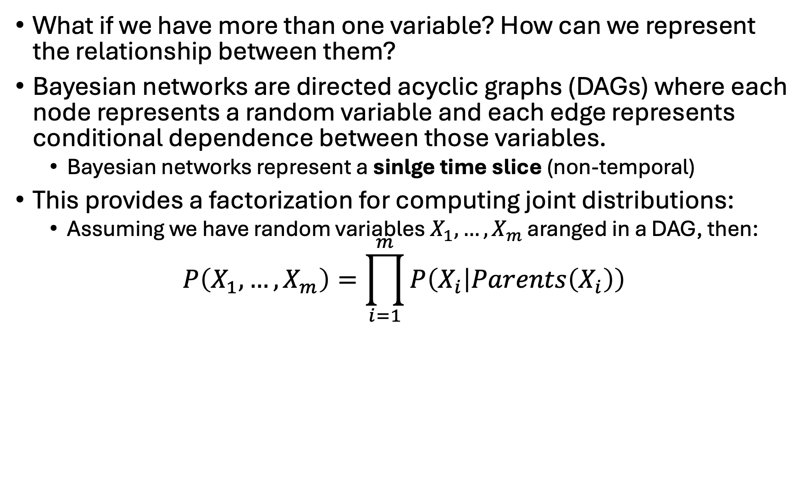
Bayesian Networks: Definition
What if we have more than one variable? How can we represent the relationship between them?
Bayesian networks are directed acyclic graphs (DAGs) where each node represents a random variable and each edge represents conditional dependence between those variables.
Bayesian networks represent a sinlge time slice (non-temporal)
This provides a factorization for computing joint distributions:
Assuming we have random variables $X_{1},…,X_{m}$ aranged in a DAG, then:
$$P\left(X_{1},…,X_{m}\right)=\prod_{i=1}^{m}{P\left(X_{i} | Parents\left(X_{i}\right)\right)}$$
Why is this Markov?

Slide 16

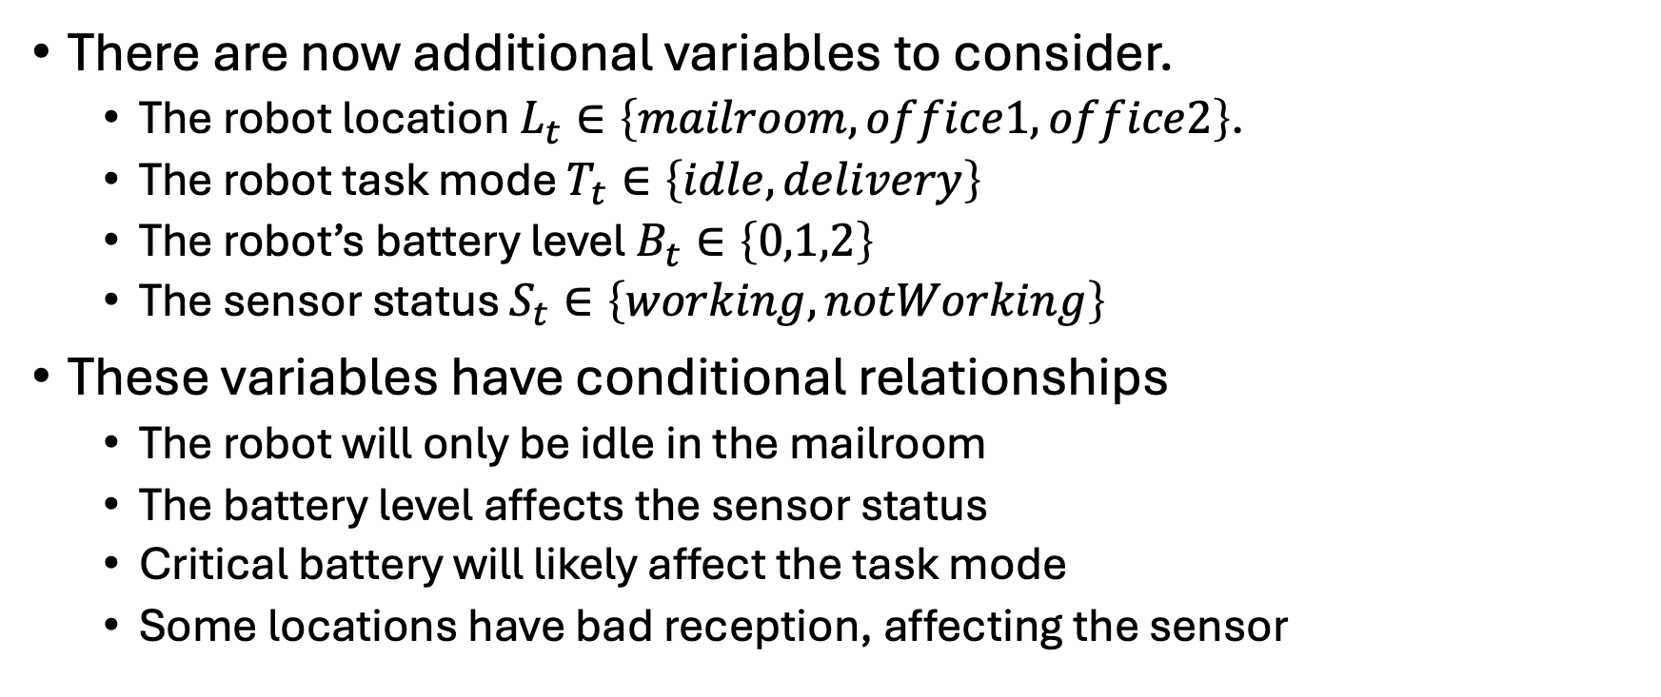



Bayesian Networks: Example
$$B_{t}$$
$$T_{t}$$
There are now additional variables to consider.
The robot location $L_{t}∈\left\{mailroom,office1,office2\right\}$.
The robot task mode $T_{t}∈\left\{idle,delivery\right\}$
The robot’s battery level $B_{t}∈\left\{0,1,2\right\}$
The sensor status $S_{t}∈\left\{working,notWorking\right\}$
These variables have conditional relationships
The robot will only be idle in the mailroom
The battery level affects the sensor status
Critical battery will likely affect the task mode
Some locations have bad reception, affecting the sensor
$$L_{t}$$
$$S_{t}$$

Slide 17



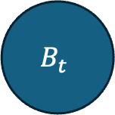

Bayesian Networks: Example (cont.)
$$B_{t}$$
Define conditional probabilities as a tables for each variable.
Markovian in DAG relationships
$$T_{t}$$
$$P\left(T | B\right)$$
$$P\left(L | T\right)$$
$$P\left(B\right)$$
$$L_{t}$$
T\B | 0 | 1 | 2
idle | 1 | 0.4 | 0.1
delivery | 0 | 0.6 | 0.9
L\T | idle | delivery
mailroom | 1 | 0.05
office1 | 0 | 0.55
office2 | 0 | 0.4
0 | 1 | 2
0.33 | 0.33 | 0.34
$$S_{t}$$
$$P\left(S | B,L\right)$$
T\B | 0,mailroom | 0,office1 | 0,office2 | 1,mailroom | 1,office1 | 1,office2 | 2,mailroom | 2,office1 | 2,office2
working | 0 | 0 | 0 | 0.5 | 0.75 | 0.6 | 0.6 | 0.99 | 0.8
notWorking | 1 | 1 | 1 | 0.5 | 0.25 | 0.4 | 0.4 | 0.01 | 0.2

Slide 18
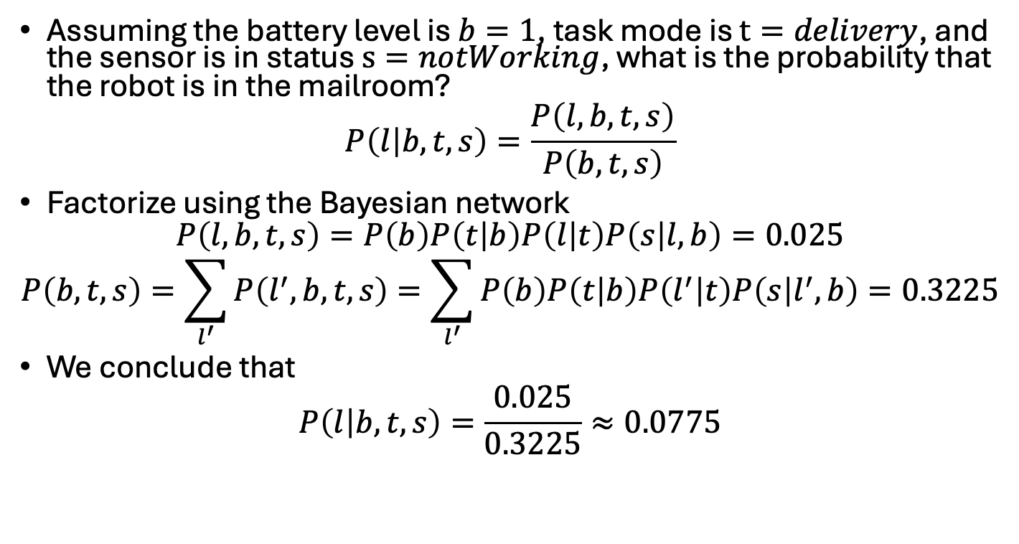
Bayesian Networks: Example (cont.)
$$B_{t}$$
Assuming the battery level is $b=1$, task mode is $t=delivery$, and the sensor is in status $s=notWorking$, what is the probability that the robot is in the mailroom?
$$P\left(l | b,t,s\right)=\frac{P\left(l,b,t,s\right)}{P\left(b,t,s\right)}$$
Factorize using the Bayesian network
$$P\left(l,b,t,s\right)=P\left(b\right)P\left(t | b\right)P\left(l | t\right)P\left(s | l,b\right)=0.025$$
$$P\left(b,t,s\right)=\sum_{l^{′}}{P\left(l^{′},b,t,s\right)}=\sum_{l^{′}}{P\left(b\right)P\left(t | b\right)P\left(l^{′} | t\right)P\left(s | l^{′},b\right)}=0.3225$$
We conclude that
$$P\left(l | b,t,s\right)=\frac{0.025}{0.3225}≈0.0775$$
$$T_{t}$$
$$L_{t}$$
$$S_{t}$$

Slide 19

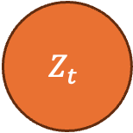

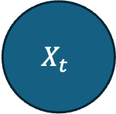

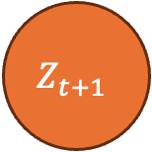
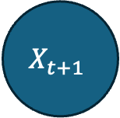
DBN: Definition
A dynamic Bayesian network (DBN) is an extension of a Bayesian network over time, as in Markov chains and HMMs.
Bayesian network only considers one time slice
DBNs = Bayesian networks + temporal edges
HMM is a special case of DBN.
Define transitions as a 2 time-slice Bayesian network (2-TBN).
Transitions between variables are transition matrices
Let’s define a HMM as a DBN:
$$X_{t}$$
$$P$$
$$X_{t+1}$$
$$O$$
$$O$$
$$Z_{t}$$
$$Z_{t+1}$$

Slide 20

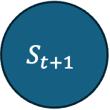

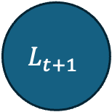

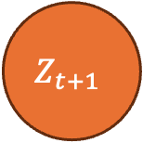
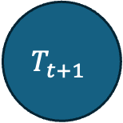
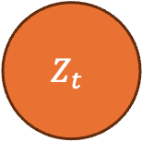
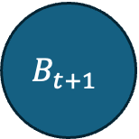

DBN: Example 2-TBN
$$B_{t}$$
$$B_{t+1}$$
Next battery charge depends on previous charge + task mode
Next location depends on previous location + task mode
Current task mode depends only on current battery charge
Observation depends on current location and sensor status
$$T_{t}$$
$$T_{t+1}$$
$$L_{t}$$
$$L_{t+1}$$
$$S_{t}$$
$$Z_{t}$$
$$Z_{t+1}$$
$$S_{t+1}$$

Slide 21
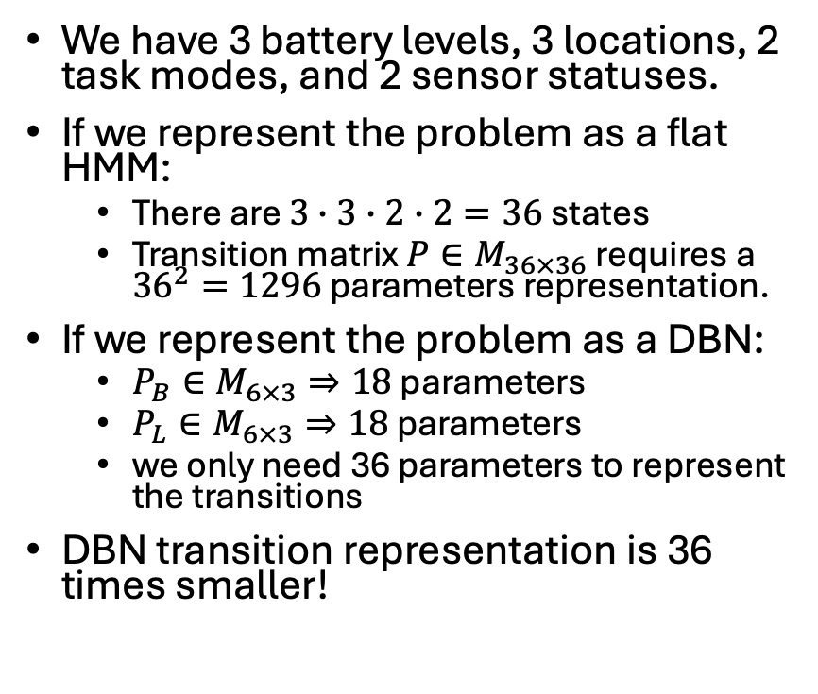
DBN: Example HMM vs DBN
$$B_{t}$$
$$B_{t+1}$$
We have 3 battery levels, 3 locations, 2 task modes, and 2 sensor statuses.
If we represent the problem as a flat HMM:
There are $3∙3∙2∙2=36$ states
Transition matrix $P∈M_{36×36}$ requires a ${36}^{2}=1296$ parameters representation.
If we represent the problem as a DBN:
$P_{B}∈M_{6×3}⇒18$ parameters
$P_{L}∈M_{6×3}⇒18$ parameters
we only need 36 parameters to represent the transitions
DBN transition representation is 36 times smaller!
$$T_{t}$$
$$T_{t+1}$$
$$L_{t}$$
$$L_{t+1}$$
$$S_{t}$$
$$Z_{t}$$
$$Z_{t+1}$$
$$S_{t+1}$$

Slide 22
Summary?
We learned about three stochstic Markov processes
Markov chain
HMM
DBN
We saw that Markov chains converge to stable state distributions.
We showed how to track belief when the true state is hidden.
We showed the benefit of factorizing stochastic processes via Bayesian networks and how it reduces the model complexity.
But these models do not allow us to take action and control the outcome of the system. From now on, we will focus on decision processes.
Markov decision process (MDP) adds control to a Markov chains.
Partially observable MDP (POMDP) adds control to HMMs.

